Slide 1

PROJECT TITLE:
Gen Therapist – AI Chatbot for CBT
MINOR PROJECT (AIDS 451)
WELCOME TO
BENNETT UNIVERSITY
Presented by : Prachi Aggarwal
Enrolment No : 02518011922 Supervisors : Muntaha Rouf
Semester : 7

Slide 2
INTRODUCTION
Gen Therapist is an AI-powered chatbot designed to provide Cognitive Behavioral Therapy (CBT)–based emotional support. It uses Natural Language Processing to engage in empathetic and meaningful conversations, helping users manage stress, anxiety, and negative thoughts. The chatbot offers a private, accessible, and affordable solution for improving mental well-being anytime and anywhere.

Slide 3
AI-based chatbots using CBT methods have shown positive results in reducing anxiety and depression.
Studies highlight the success of tools like Woebot and Wysa in providing emotional support through conversation.
Natural Language Processing (NLP) enables chatbots to understand user emotions and respond empathetically.
Research suggests virtual therapy can be a cost-effective and scalable alternative to human counseling.
Chatbots ensure privacy and accessibility, encouraging users to seek help without stigma
Continuous improvements in machine learning are enhancing the accuracy and personalization of therapy responses.
Problem Statement
Literature Survey

Slide 4
Data Collection — Gather CBT therapy scripts, anonymized counseling transcripts, and relevant conversational datasets.
Preprocessing — Clean text, tokenize, remove noise, label intents, and perform sentiment/emotion tagging.
Model Development — Fine-tune a pre-trained NLP model (e.g., BERT/GPT) for intent recognition and response generation.
Dialogue Management — Combine rule-based CBT flows with ML-driven responses to keep therapy safe and focused.
CBT Module Integration — Implement guided exercises (thought records, behavioral experiments, breathing) and structured prompts.
PROPOSED METHODOLOGY
Notes:
Cancer is a genetic disease that can occur in any organ. It occurs due to genetic changes due to DNA damage.
Genes in the DNA dictate how cells divide and grow.
So when the genes are damaged, the cell division and growth become irregular.
This uncontrolled growth in cells can happen due to exposure to hazardous chemicals, UV rays, genetic inheritance etd.

Slide 5
UI & Backend — Build a simple web/mobile interface with secure user sessions and conversation logging.
Testing & Evaluation — Conduct user testing, clinical validation (if possible), measure engagement and symptom
change, and iterate.

Slide 6
PROPOSED METHOLOGY
Data Collection: Use CBT therapy scripts, conversational datasets.
Preprocessing: Tokenization, stop-word removal, sentiment analysis.
Model Development: Train NLP-based chatbot models.
Dialog Management: Rule-based + ML-driven responses for CBT exercises.
User Interaction Layer: Web/mobile app interface.
Testing & Feedback: Validate effectiveness through user trials.

Slide 7
Kolimi, R. et al. (2022). AI-Powered Chatbots for Mental Health Support Using CBT Techniques. Journal of Artificial Intelligence Research.
American Psychological Association (2021). Effectiveness of Cognitive Behavioral Therapy for Anxiety and Depression.
ICMR–NCDIR (2021). Mental Health and Well-Being Report – India.
Fitzpatrick, K. K., Darcy, A., & Vierhile, M. (2017). Delivering CBT via Conversational Agent (Woebot): Randomized Controlled Trial. JMIR Mental Health.
Wysa Labs (2022). AI-Driven Mental Health Chatbot – Technical Overview and User Studies.
REFERENCES

Slide 8
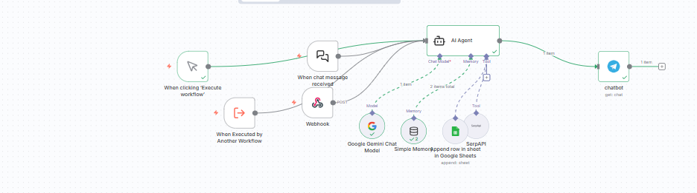
SCREENSHOTS

Slide 9
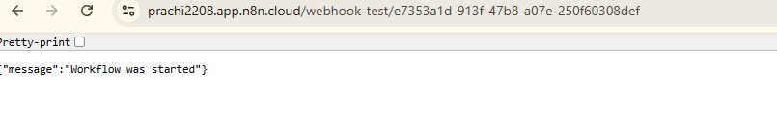
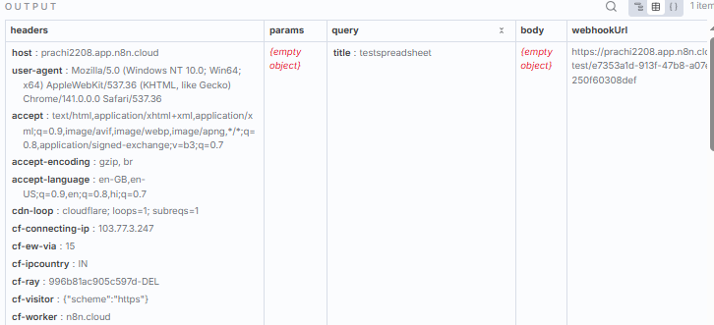
WEBHOOK TESTING

Slide 10
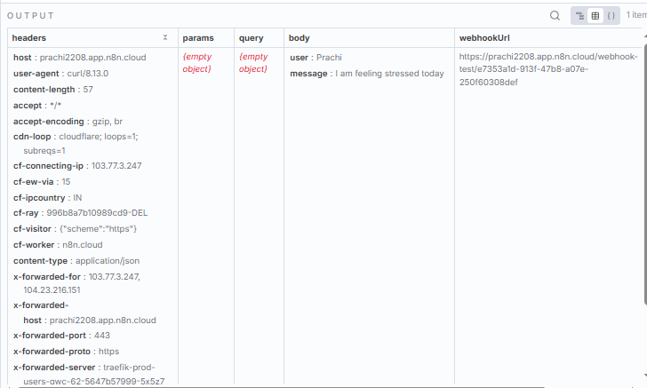
WEBHOOK TESTING
curl -X POST "https://prachi2208.app.n8n.cloud/webhook-test/e7353a1d-913f-47b8-a07e-250f60308def" -H "Content-Type: application/json" -d "{\"user\":\"Prachi\",\"message\":\"I am feeling stressed today\"}"

Slide 11
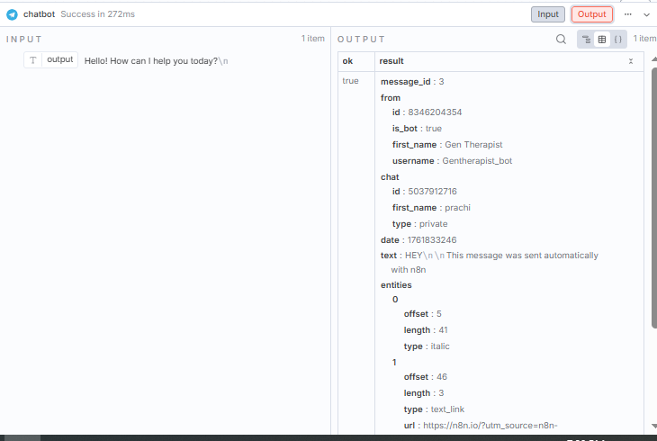
TELEGRAM TESTING

